Slide 1


Enhanced Customer Support Chatbot for Electronic Gadgets Retail
The retail industry demands intelligent systems to streamline customer service. Our project develops an advanced chatbot for electronic gadget stores. It ensures instant assistance on products, warranties, orders, and more, enhancing customer satisfaction and operational efficiency.

Slide 2



Project Overview
02
The retail industry has seen an increasing demand for intelligent systems that streamline customer service. In particular, electronic gadget retailers benefit from an enhanced customer support chatbot that can provide instant assistance. This project aims to design and implement a customer support chatbot for an electronic gadgets retail store. It uses an intelligent chatbot system capable of answering queries related to products, warranties, shipping, order tracking, and more. This solution ensures efficient handling of customer inquiries, boosting both customer satisfaction and operational efficiency.

Slide 3



03
Working
Intent Detection:
Fuzzy Search:
Dynamic Responses
The chatbot analyzes user queries for specific intents such as product details, order tracking, and payment methods using keyword matching.
It uses fuzzy matching to identify products based on partial user queries, ensuring accurate responses even with ambiguous or incomplete product names.
Based on the detected intents, the chatbot pulls information from the FAQ database and generates dynamic responses, improving the user experience.

Slide 4

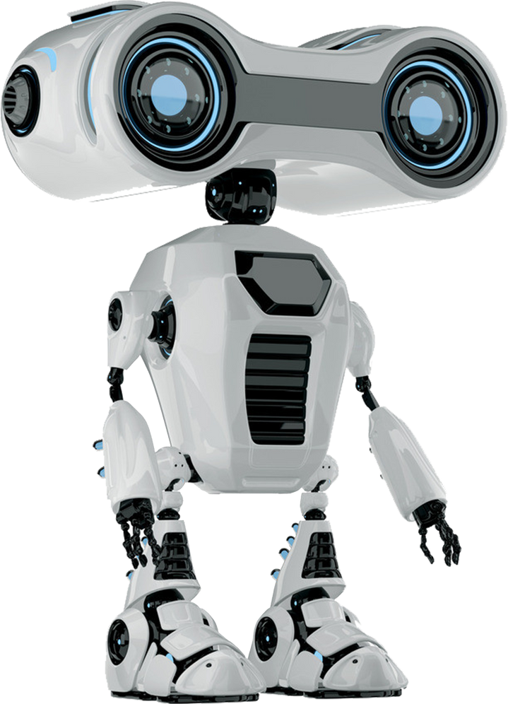
Challenges
04
Natural Language Understanding: Understanding the natural language of customer queries posed a challenge, especially when the queries were vague or used non-standard terminology. The fuzzy search and keyword-based intent detection helped mitigate this issue.
Context Management: Maintaining the context of the conversation across multiple exchanges was crucial for delivering accurate and helpful responses. This was achieved by storing and referencing past interactions in conversation history.
Scalability: As the FAQ database grows, ensuring the chatbot remains efficient and responsive was a concern. Optimization techniques were implemented to handle a larger dataset without compromising performance.
User Experience: Ensuring the chatbot provides a human-like interaction while avoiding confusion or irrelevant responses required careful attention to the design of the response system and conversation flow.

Slide 5

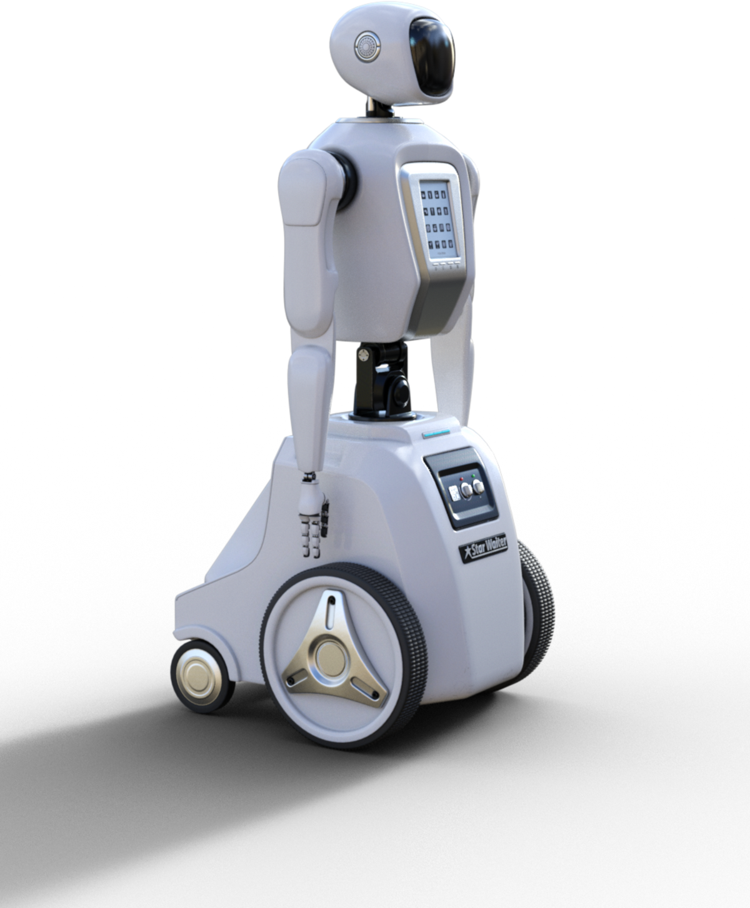
Conclusion
The enhanced customer support chatbot offers an efficient, scalable, and contextually aware solution for answering customer queries in the electronic gadgets retail sector. By leveraging advanced techniques such as fuzzy matching, intent detection, and conversation history, the system provides real-time assistance and improves customer satisfaction. Despite challenges such as natural language understanding and context management, the project demonstrates the potential of chatbots to revolutionize customer service in the retail industry. Moving forward, further improvements can be made to handle more complex queries and integrate additional functionalities like order placement and personalized recommendations.
05

Slide 6


Thank You!

